Slide 1
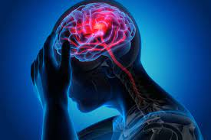
Can You Predict A Stroke?
Michelle Jun

Slide 2
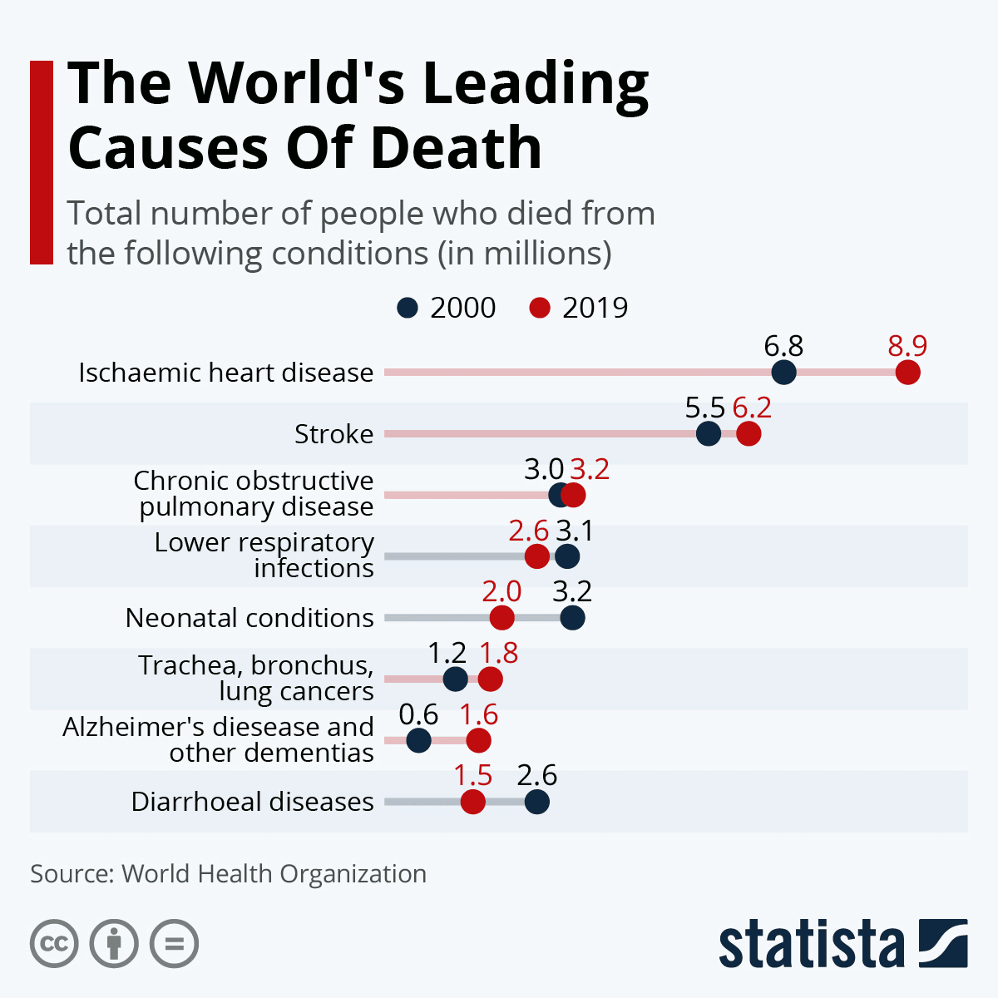
Did you know?

Slide 3
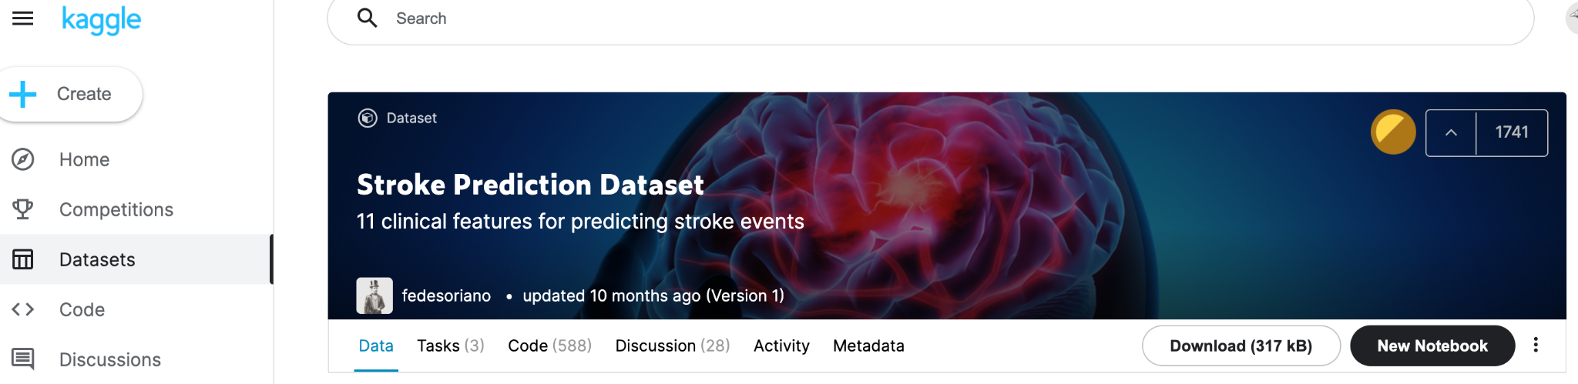
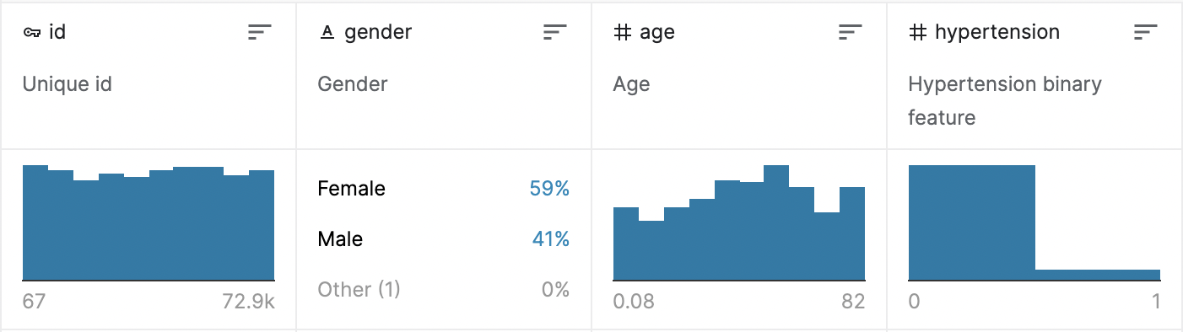
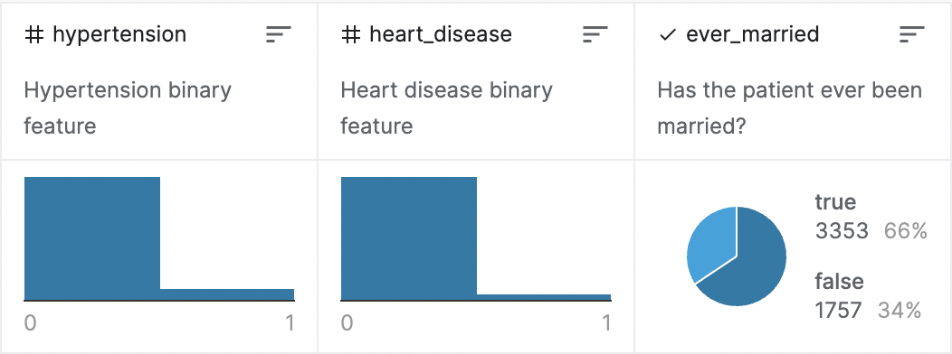
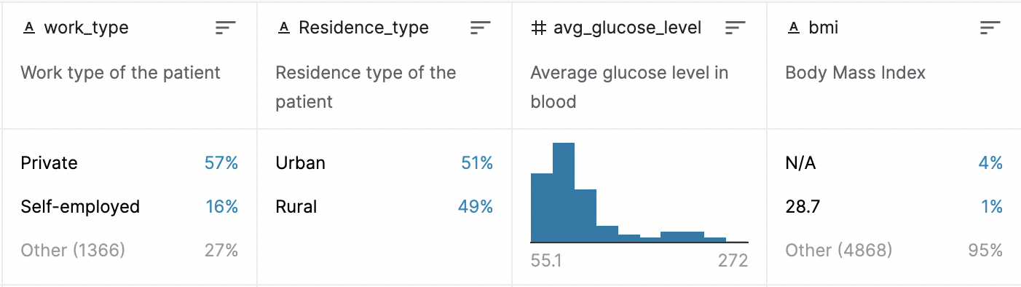
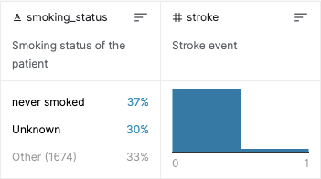
Dataset

Slide 4
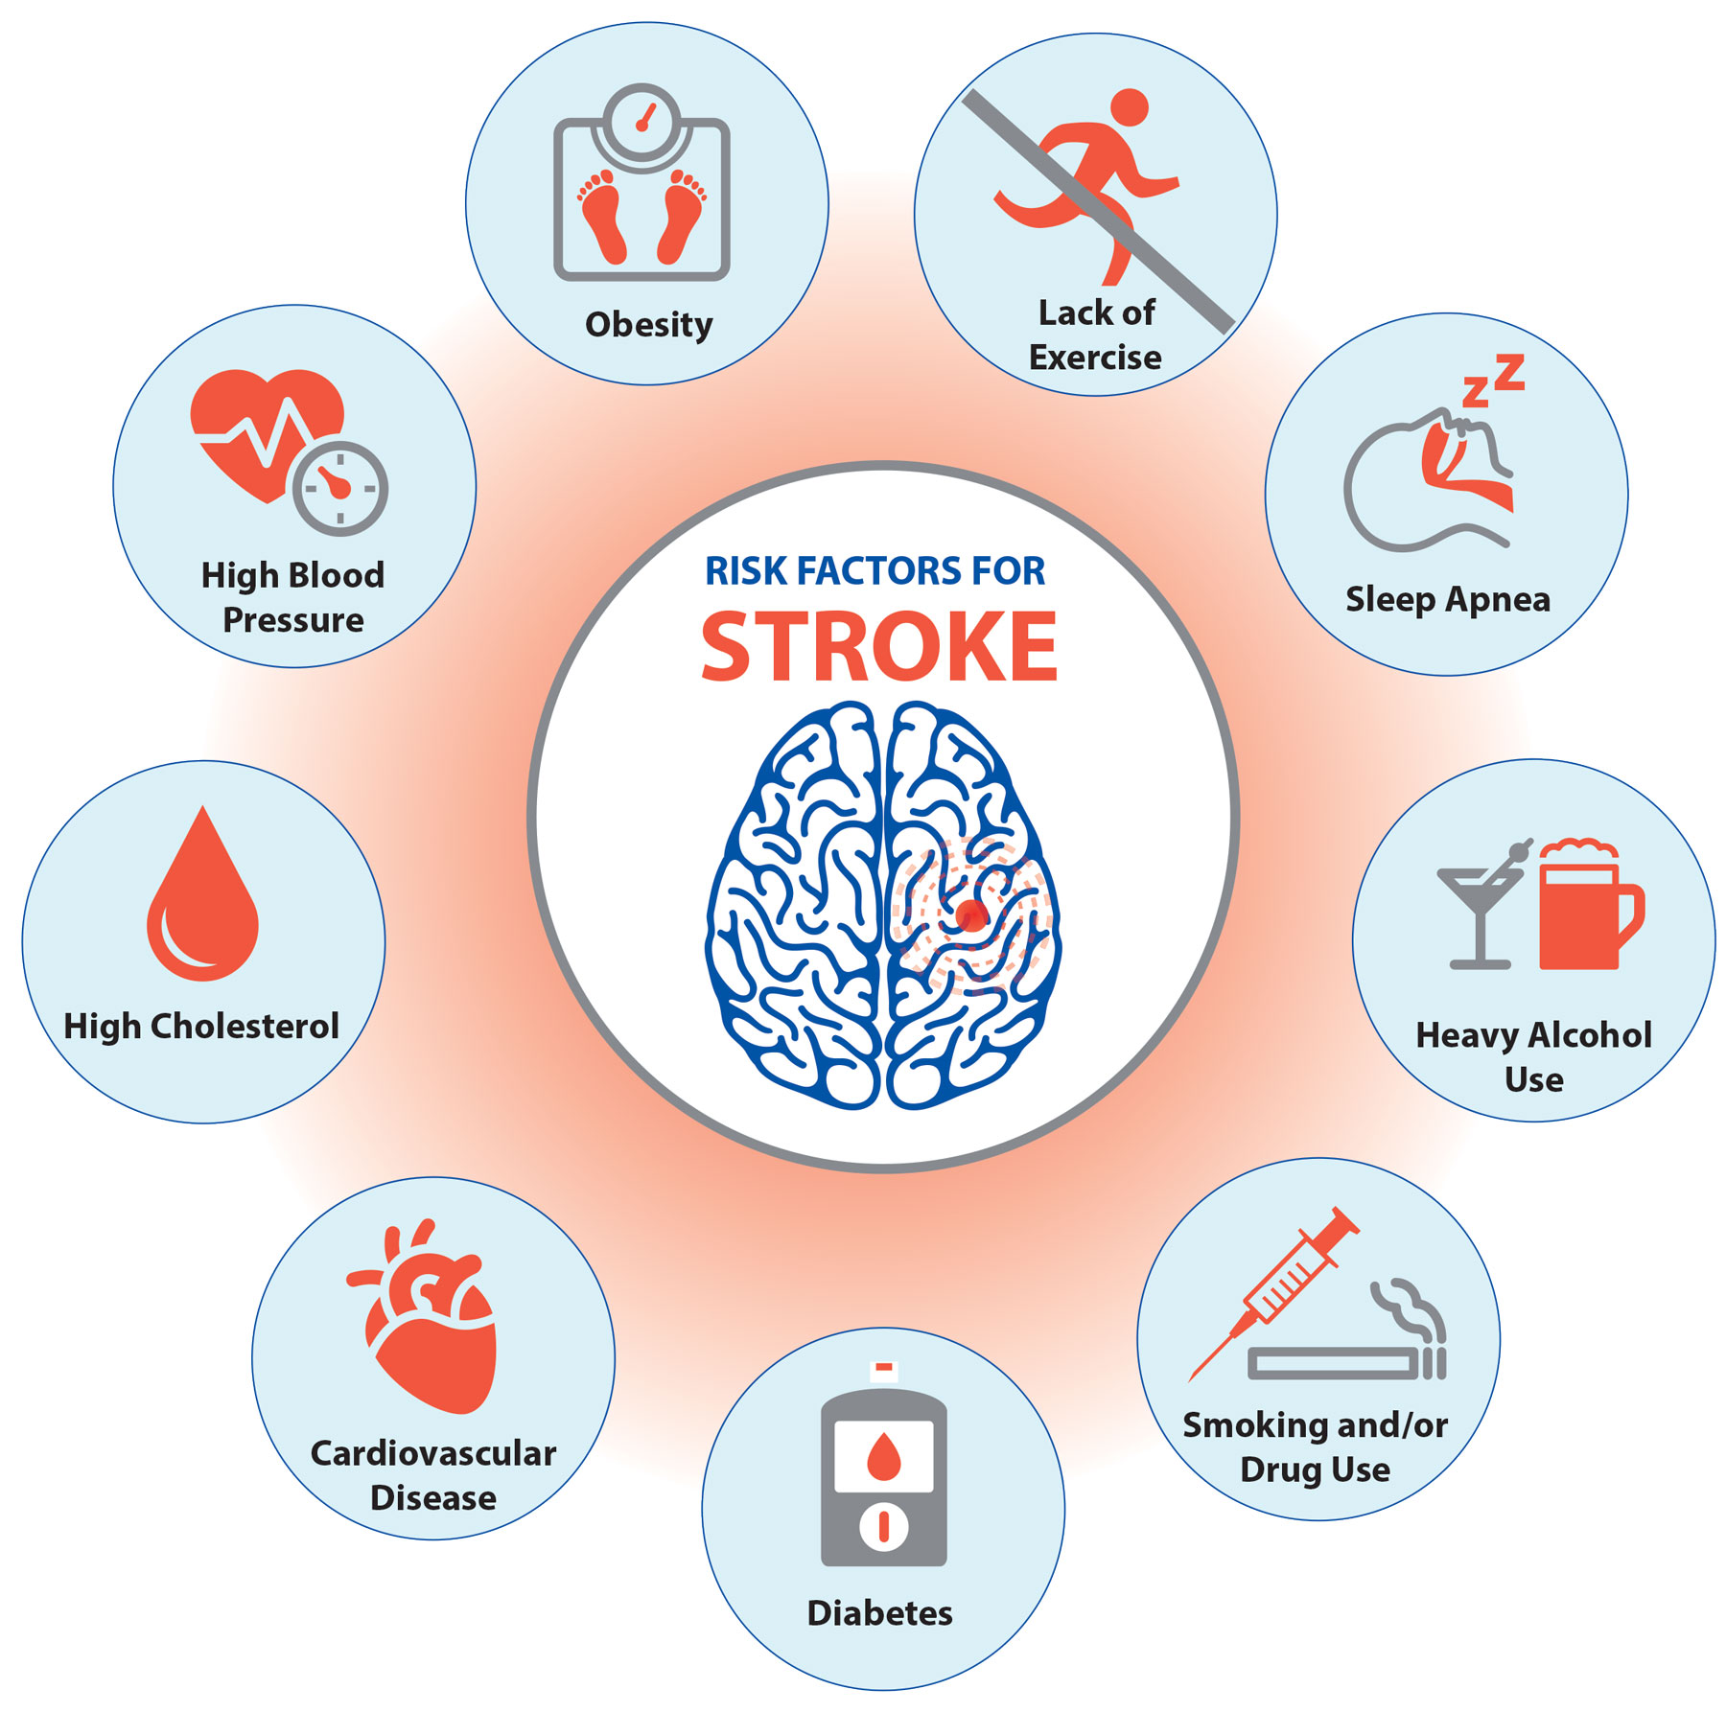
Main Question

Slide 5
Research Questions
What is the relationship between hypertension, gender, age, and bmi in this dataset? Furthermore, how does the relationship between hypertension, gender, age, and bmi change for people who have had a stroke?
For the people living across the world who have had a stroke, is there an association between having a stroke and living in a rural area versus an urban area?
Is there a linear relationship between age and hypertension, heart disease, average glucose level, and bmi in the sample?
Is there a linear relationship between the log-odds of someone having a stroke and if they smoked, age, history of heart disease (hypertension), average glucose level, and bmi?

Slide 6
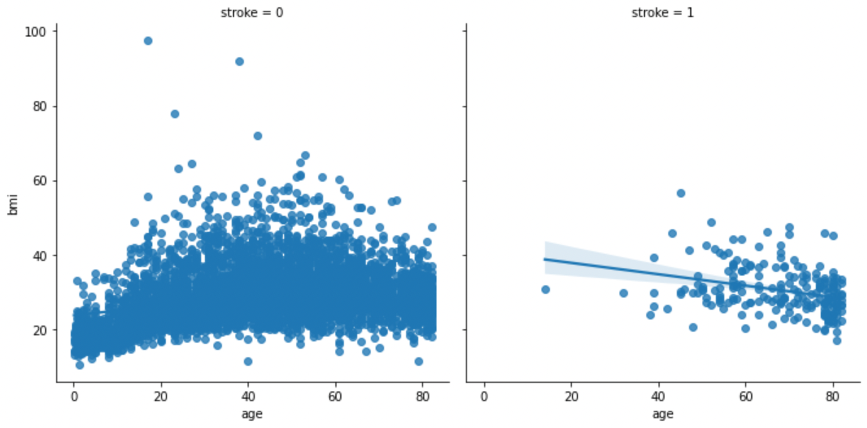
Is there a relationship between age, bmi, and stroke?

Slide 7
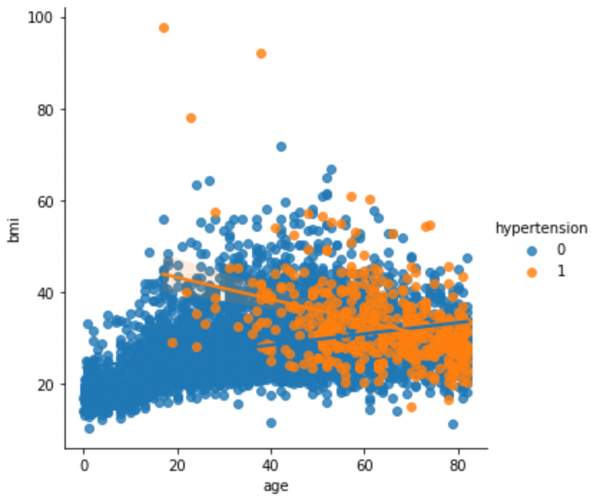
Is there a relationship between age, bmi, and hypertension?

Slide 8
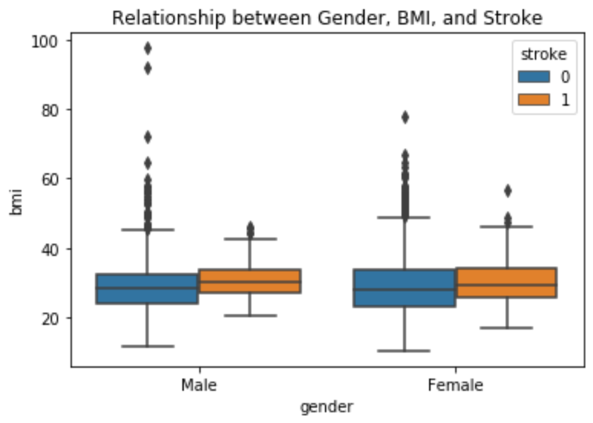
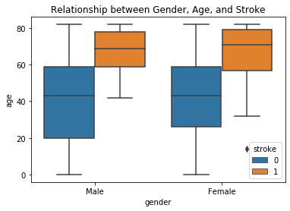
Is there a relationship between gender, BMI/Age, and stroke?

Slide 9
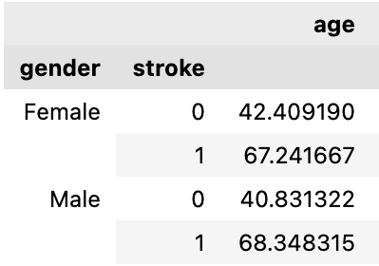
Mean Age

Slide 10
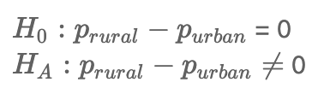

Are Strokes More Likely In Urban or Rural Areas?
CLT Conditions
Null
Hypothesis

Slide 11
Linear relationship between age and hypertension, heart disease, average glucose level, and BMI
R² = 22.3%
If someone has no history of hypertension, does have a history of heart disease, an average glucose level of 170, and a bmi of 32, how old will they be?
69

Slide 12
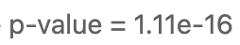
Linear relationship between age and hypertension, heart disease, average glucose level, and BMI
Linear Regression Conditions
Null
Hypothesis

Slide 13

Is there a linear relationship?
Hypertension
Heart Disease
Glucose Level
BMI

Slide 14
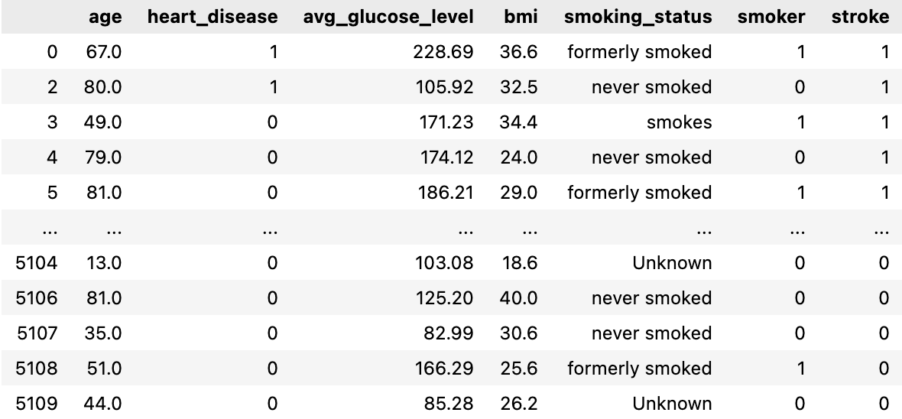
Logistic Regression
Is there a linear relationship between the log-odds of someone having a stroke and if they smoked, age, history of heart disease, average glucose level, and BMI?

Slide 15
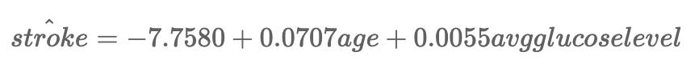
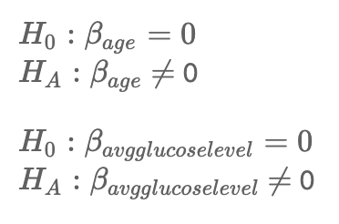
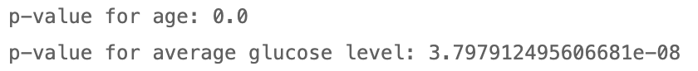
Building a parsimonious model
Logistic Regression Conditions
Null
Hypothesis

Slide 16

Is there a linear relationship?
Smoke
Age
Heart Disease
Glucose Levels
BMI

Slide 17
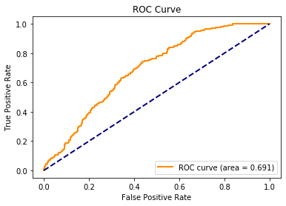
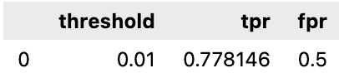
ROC Curve

Slide 18
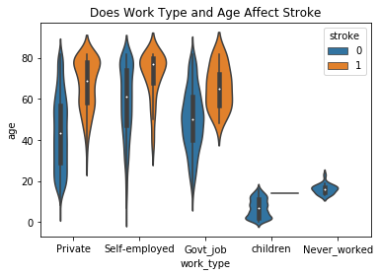
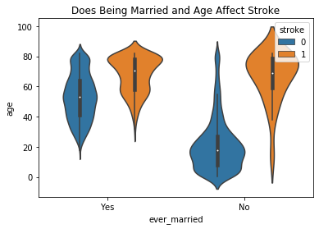
Additional Analysis

Slide 19
Conclusion

Slide 20

Future Testing

Slide 21
THANK YOU!

